Slide 1


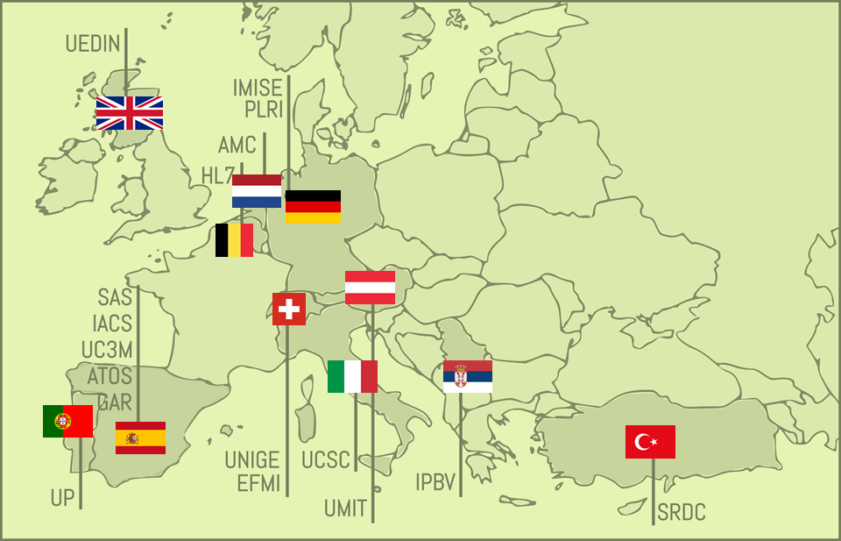


Improving Health Research in EU through FAIR data
EXPECTED OUTPUTS RELATED TO EOSC
TECHNOLOGY
FAIRification process applied to health data
RESEARCH
eService for health researchers
eService for health care organisations
FAIR dataset including up to 5 mill. subjects
POLICIES
Guideline for Health Research Organisations to implement a FAIR data policy
AWARENESS RAISING
Reports, dissemination materials and training on the FAIRification of health data
EC funding: 2,999,053.75 € Grant Agreement 824666
www.fair4health.eu
@FAIR4Health
Notes:
First of all, I’d like to thank the organisers for the opportunity to share with you our project. FAIR4Health started on last December and we are looking forward to establish collaborations and synergies at any level with all EU initiatives dealing with FAIR data in the health domain. So in case you are involved in other similar initiatives, please don’t hesitate to contact me at the end of the session and I will put you in contact with the coordinators to set out potential collaborations.

